Slide 1
Non-functional Requirements

Slide 2
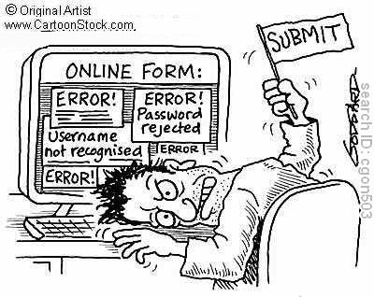
Non-Functional Requirements
Usability
Reliability
Availability
Security
Maintainability
Portability
Performance

Slide 3

Usability
General GUI
Use Vietnamese as much as possible in texts, images, messages, help documents
Simple, elegant interface
End-user
Easy-to-use search tool
TODO: Help/support page
User can use most of main functions without registering and logging in

Slide 4
Usability
Admin/staff
Admin should need minimal training to use and manage the system
Detailed help for admin should be available in a separate document
Installation
Easy deployment
Detailed deployment manual available

Slide 5
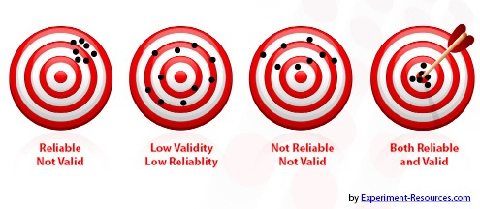
Reliability

Slide 6
Reliability
Initial data must be collected carefully and correctly
Database should be backed up regularly and can be restored if necessary
Can filter bad posts
Does not conflict with other software
Mean Time To Repair: as quick as possible. Estimated time is 1 day.
Defect rates: should be 5 bugs/KLOC

Slide 7

Availability
System should run 24/7
Can be turned off for maintenance
Up time should be at least 99%, depend on hosting service

Slide 8

Security
Privacy
All information regarding users must not be available for anyone or software that is not part of the system
User password is also invisible for the system administrator with MD5 encryption
Provide user with a password recovery method

Slide 9

Maintainability
Coding standards
Implemented code must be easy to maintain
All code should be clearly commented, including class, method documentations
Design
The design of the system must be loosely coupled that changes on some module will not affect others
Logging
All the errors should be logged, supporting bug fixing and maintenance

Slide 10
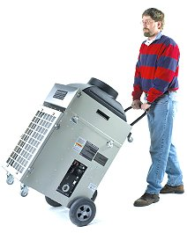
Portability
Anyone can use the website with a browser and an internet connection

Slide 11

Performance
Load time
Every page should be completely displayed within: average 1.5 second and maximum 5 seconds.
Searching should return and display the result within 2 seconds.
Frequently accessed data must be cached
Mailing
Mail server should send emails within 1 minute after associated events happen

Slide 12
Performance
Capacity
The system should serve correctly and reasonably with at least 1000 online users at a moment.
The system can store at least 100000 houses and 10000 users without affecting the loading speed.
If the system is busy, it should to inform users about that
Compatibility
The system should provide elegant responses for nowadays common screen resolutions: 1024*768, 1280*800.
The output must be compatible with all common browsers with recent build: Mozilla Firefox, Internet Explorer, Google Chrome, Apple Safari, and Opera

